Slide 1

Advantages of enabling the SQL IaaS extension

Slide 2
SQL Server IaaS Agent Extension benefits
For customers: SQL Server on Azure Virtual Machines saves money and simplifies management of security, high availability, and storage administration
Optimize cost | Enhance Security | Boost uptime | Simplify management
See all your SQL Server on Azure VMs in one location, convert between license types, and save by paying only for what you use. | Manage security patching and easily implement encryption features for better security and compliance. | Automate backup, easily configure high availability, and take advantage of HA/DR license benefits to enhance business continuity. | Automatically implement storage best practices and configure your storage settings more optimally for SQL Server.
Inventory Management: Counts licenses of different types and helps you understand your data estate. Flexible licensing: Enables immediate conversions between PAYG and Azure Hybrid Benefit (AHB) as well as between Developer and Enterprise edition. In-place edition updates: Enables upgrades or downgrades of SQL Server edition for supported upgrade paths with no availability impact. | Automated Patching: Automates installation of SQL Server Security updates within customer defined maintenance window. Azure Key Vault Integration: Enables customers to configure Azure Key Vault for the SQL Server instance to leverage Key Vault for Transparent Database Encryption(TDE), Column Level Encryption and Always Encrypted. | Automated backup: Sets up SQL Server backups with various options. Automated high availability configuration: Enables customers to configure Always On availability groups for SQL Server on virtual machines. Disaster Recovery license type: Leverage SQL Server HA/DR Software Assurance benefits in Azure. Enable using Azure as a Disaster Recovery site for your on-premises SQL Server. | Automated storage management: Simplifies storage configuration while setting up the virtual machine using pre-configured storage. Centralized administration: Easily manages your SQL VM and SQL PaaS deployments from one central location. Implement best practices: Enables you to deploy SQL Server with pre-configured best practices.

Slide 3
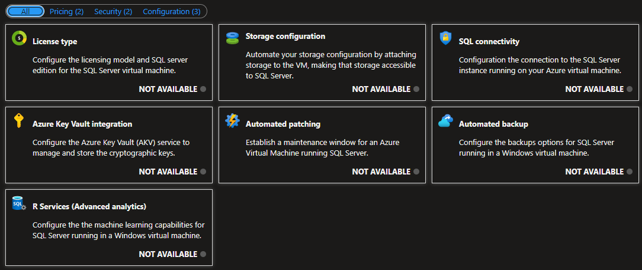

Slide 4
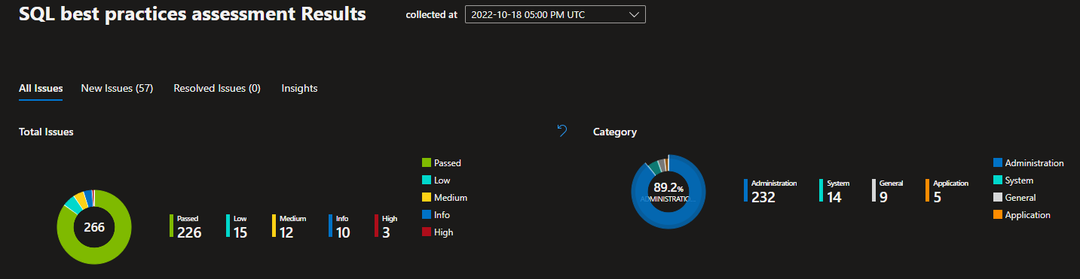
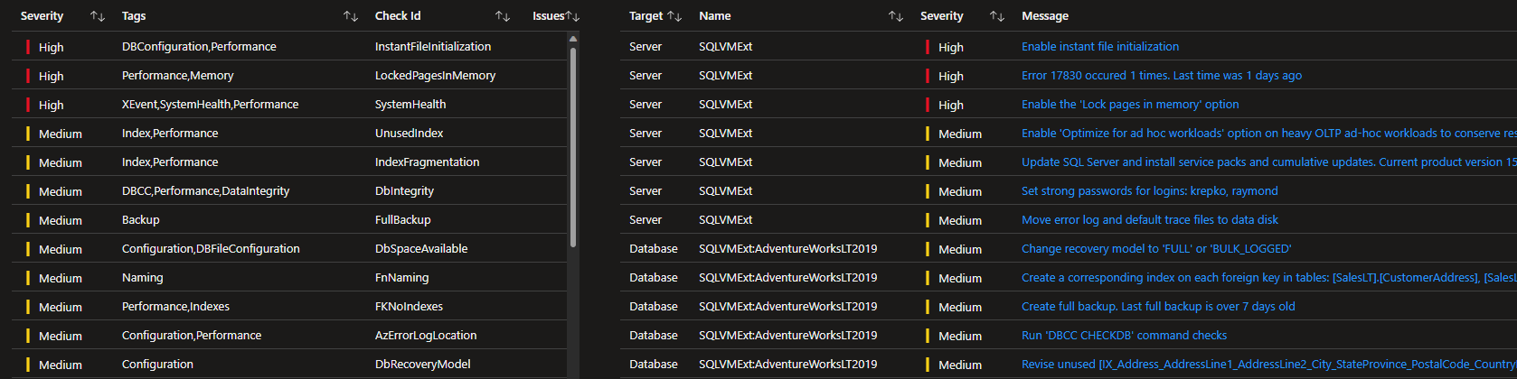

Slide 5
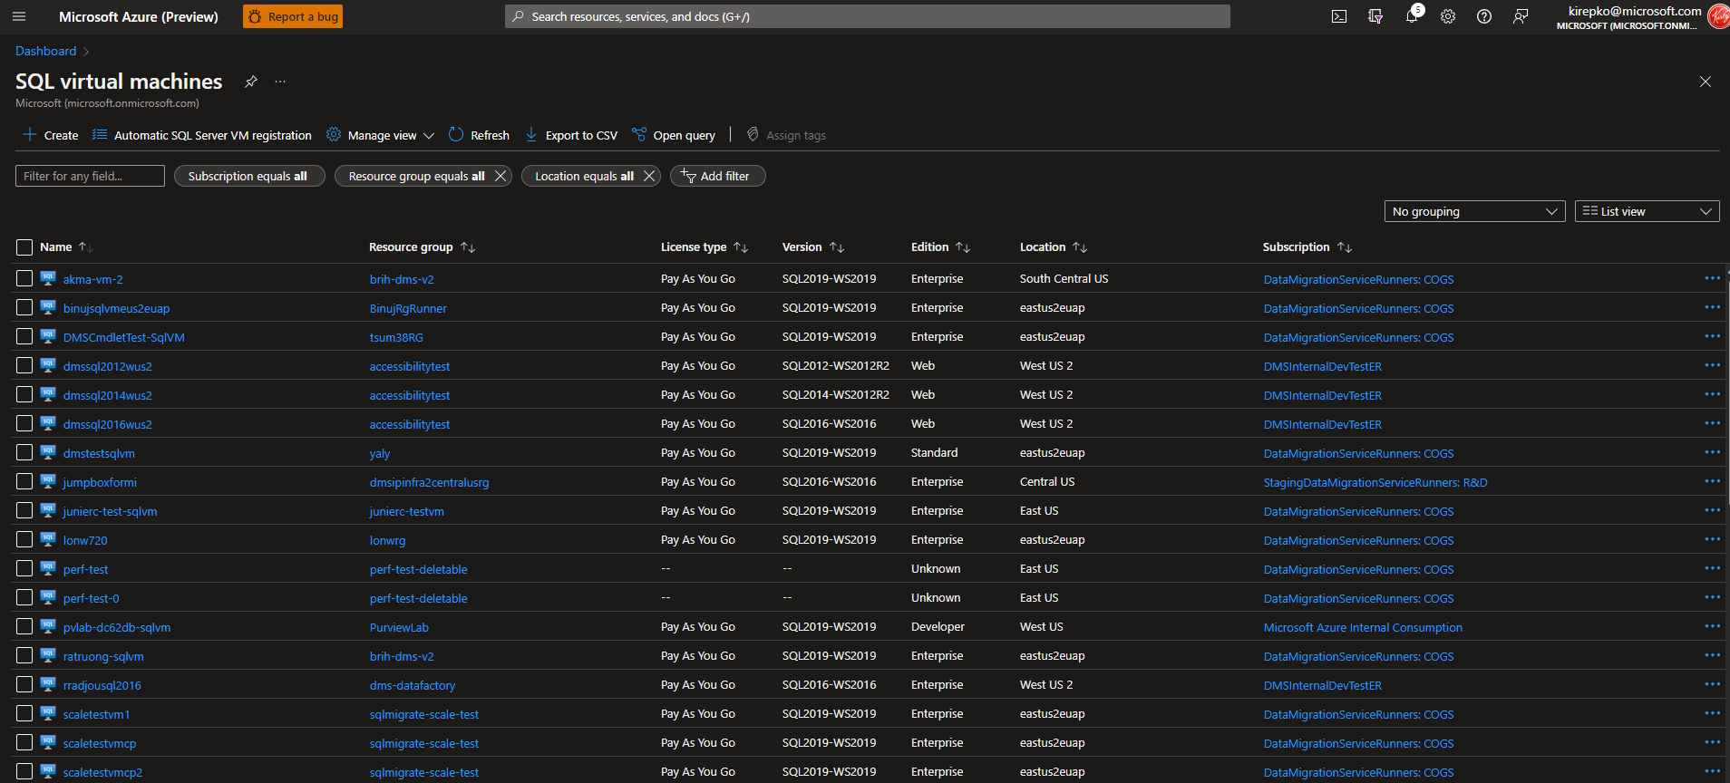

Slide 6
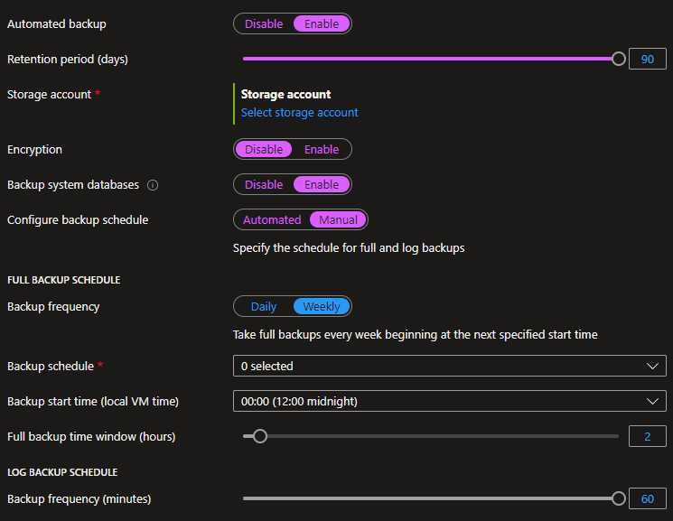

Slide 7
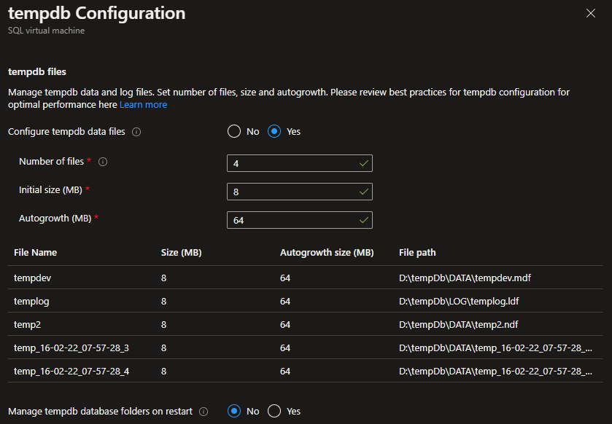

Slide 8
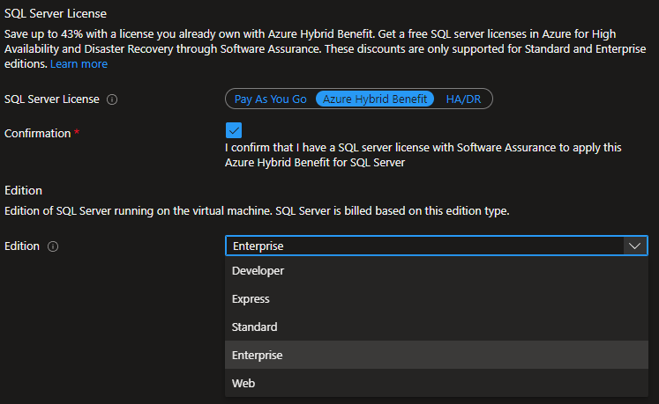

Slide 9
Enhance Security

Slide 10
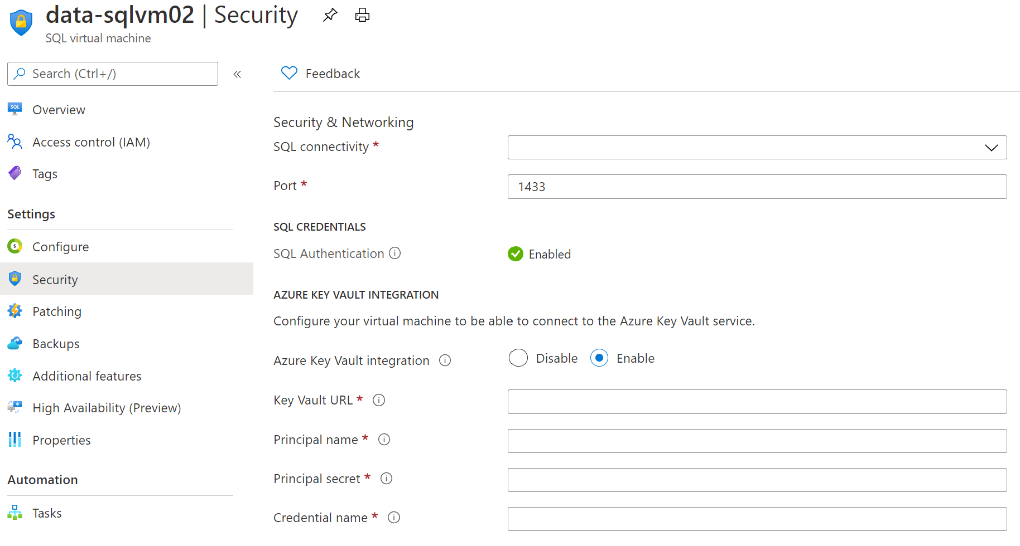
Azure SQL IaaS Extensions - Azure Key Vault Integration
Different SQL Server encryption features, such as transparent data encryption (TDE), column level encryption (CLE), and backup encryption, require you to manage and store the cryptographic keys you use for encryption.
The Azure Key Vault service is designed to improve the security and management of these keys in a secure and highly available location.
When this feature is enabled, it automatically installs the SQL Server Connector, configures the EKM provider to access Azure Key Vault, and creates the credential to allow you to access your vault.
Create a new key vault using New-AzKeyVault command. It will return vaultUri property, which is the key vault URL.
After key vault is created, add your keys to the key vault.
Steps:
Notes:
The SQL connectivity feature allows you to do the following:
Set the port for the SQL Server instance to ensure that you are able to listen on another port other than a well-known port.
Configure the connectivity rules to make it as restrictive like allowing local connectivity only or opening it up to public internet for external applications and clients to connect to the SQL Server instance (see screenshot below).
Enable SQL Authentication for the SQL Server instance if your applications and users require this authentication method.
Configure Azure Key Vault for the SQL Server instance to leverage Key Vault for Transparent Database Encryption, Column Level Encryption and Always Encrypted features of SQL Server to enable encryption of data at rest and in motion.

Slide 11
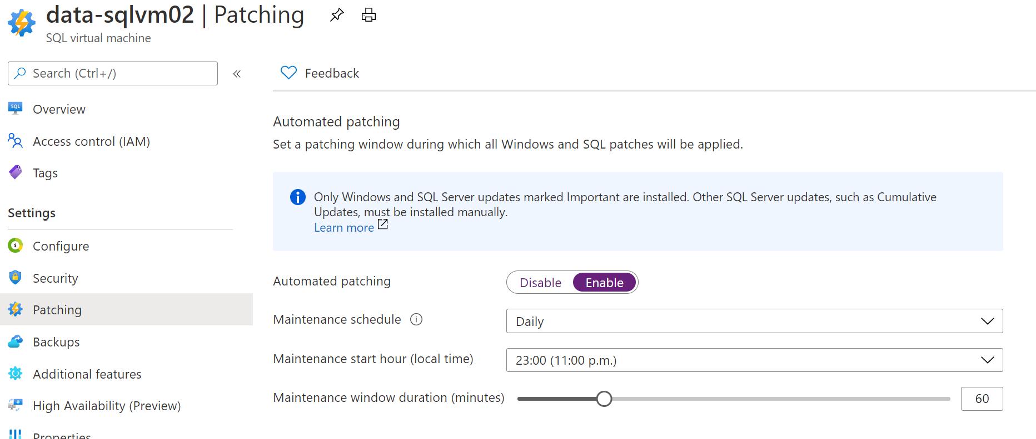
Azure SQL IaaS Extensions - Automated Patching Feature
The Automated Patching feature allows a SQL Server administrator to select a maintenance window schedule for applying Important Windows Server and SQL Server updates that are distributed through the Windows Update channel.
Notes:
Security is a key area of interest for any database administrator who is responsible for securing and protecting business data stored in a SQL Server database. Sometimes compliance requirements drive security needs like encryption of data at rest. SQL Server on Azure Virtual Machines make security management easier through patching and easily implement encryption features for better security and compliance.
Extended support for SQL Server 2008 and SQL Server 2008 R2 ended on July 10, 2019. Customers that have SQL Server 2008 R2 and SQL Server 2008 can upgrade to a newer version of SQL Server or migrate to Azure SQL Database or Managed Instance. There is also an option for customers to stay protected using Extended Security Updates for SQL Server 2008 or SQL Server 2008 R2. This is available for Free and enabled by default when migrating on-premises servers to SQL Server on Azure virtual machines. This provides you the ability to receive a critical security update when one is released or receive technical support for SQL Server 2008 or SQL Server 2008 R2 with your existing support plan without having to purchase Extended Security Update subscriptions.

Slide 12
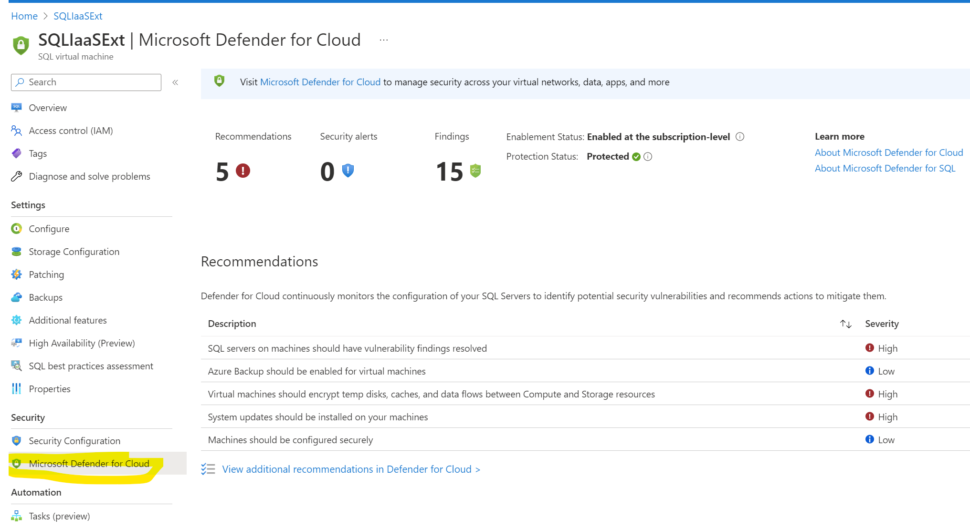
Get security recommendations right in your SQLVM blade
Notes:
In addition to the above benefits, SQL Server on Azure virtual machines also offer you the ability to
detect anomalous activities indicating unusual and potentially harmful attempts to access or exploit databases. You'll see alerts when there are suspicious database activities, potential vulnerabilities, or SQL injection attacks, and anomalous database access and query patterns.

Slide 13
Enabling these features

Slide 14
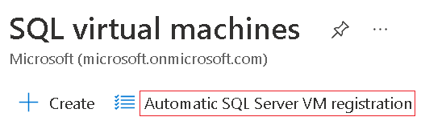
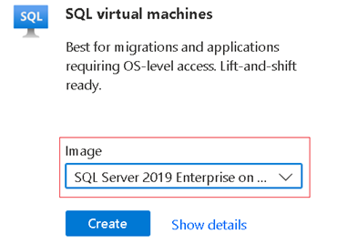
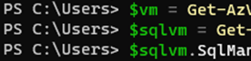
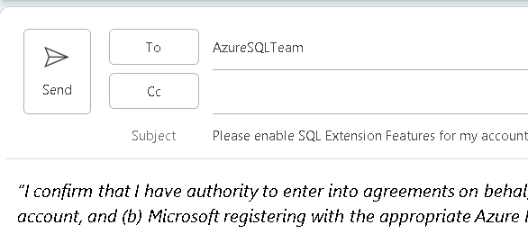
Enabling the features are easy
Click the button in Portal
One click can enable it for your subscription
Opt-in during your install of SQL Server
This is your “Error and Usage Reporting” screen
Select an Azure Image on creation
Features are turned on by default
Use the command line
PowerShell or Azure CLI, we provide the scripts
Ask us to do it for you!
We’ll provide an email template that you “sign”,
then we enable on the back-end

Slide 15
Email Template
Update the highlighted option and add your name.
Paste this text into an email and send to your account team.
In order to proceed with automatic registration of SQL Server instances running in Azure VMs for all Azure subscription IDs associated with the enrollment under which your organization obtained Azure services (i.e., your Enterprise Agreement), please respond to this email with the following paragraph to indicate your consent.
“I confirm that I have authority to enter into agreements on behalf of [INSERT CUSTOMER NAME]. On behalf of my organization, I consent to (a) Microsoft retrieving the list of Azure subscription IDs associated with my [ORGANIZATION or ENROLLMENT – pick 1 of 2 option] Azure account, and (b) Microsoft registering with the appropriate Azure Resource Provider all existing and future SQL Server instances installed on virtual machines, Linux containers or physical servers running in Azure or connected to Azure via Azure Arc in all subscription IDs associated with the agreement under which my organization obtained Azure services.”
Microsoft has a No Audit policy in support of this motion - SQL Server Privacy Supplement
With this consent, Microsoft will proceed with the registration of SQL Server instances running in Azure VMs for all Azure subscription IDs associated with the agreement under which your organization obtained Azure services (i.e., your Enterprise Agreement).
Microsoft will continue to add new benefits over time to provide the full range of manageability services that are available under the SQL IaaS Agent extension described here.
By providing consent for Microsoft to register your SQL Server VMs running on Azure on your behalf, you confirm that you have authority to enter into agreements on behalf of your organization, and you consent to allow Microsoft to access SQL Server environment information in all existing and future Azure VMs belonging to the subscription IDs associated with your organization’s Azure account.
Furthermore, you agree to permit Microsoft to register all SQL Server instances in the subscription IDs associated with your organization’s Azure account with the SQL VM Resource Provider as described here: https://docs.microsoft.com/en-us/azure/azure-sql/virtual-machines/windows/sql-vm-resource-provider-register?tabs=azure-cli%2Cbash

Slide 16
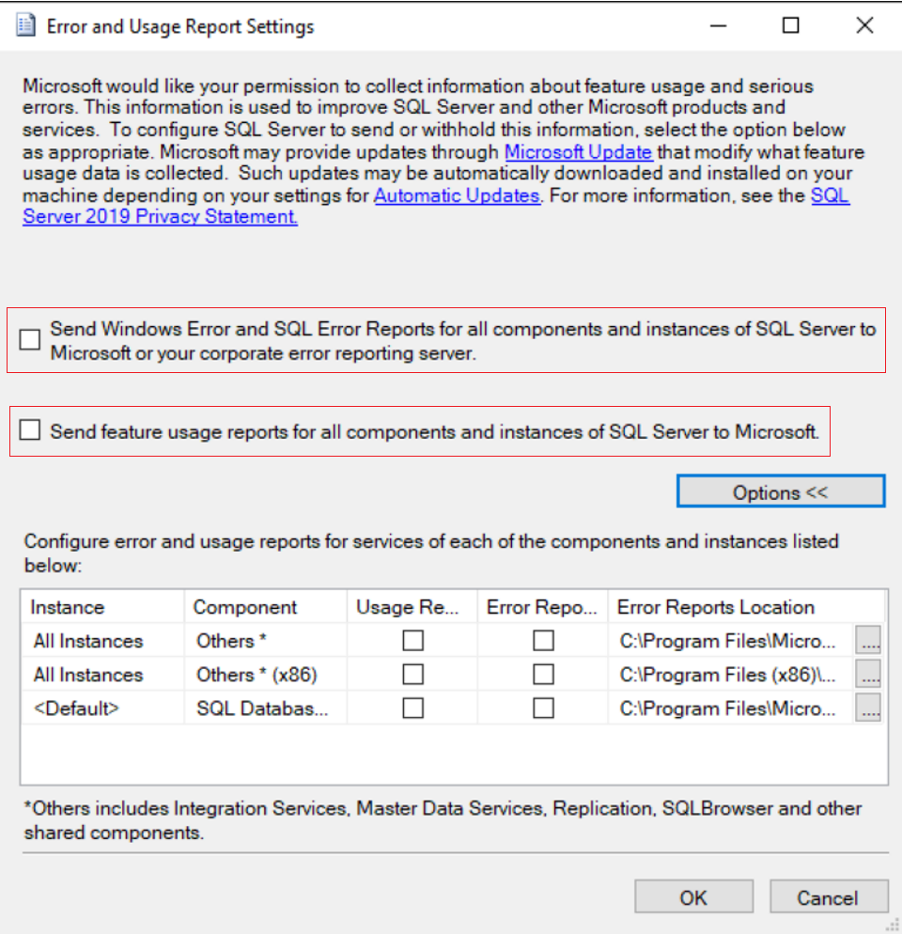
Enable during Install
Selecting the boxes below on your custom install of SQL Server enables the features.

Slide 17
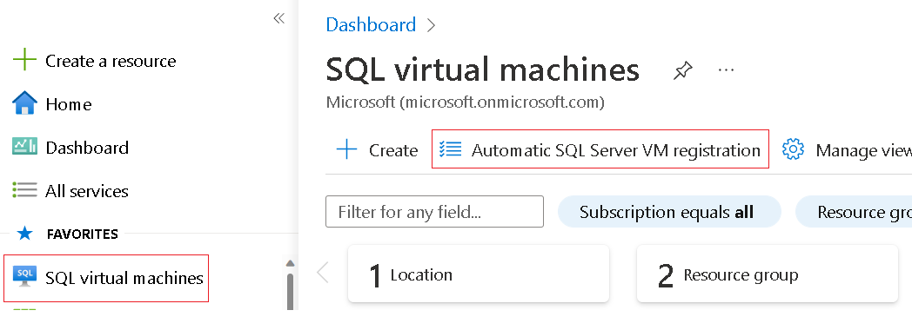
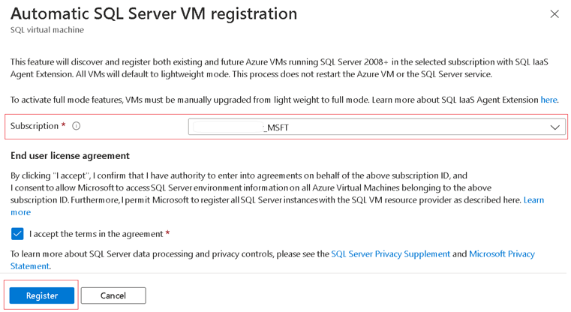
Click the button in Azure Portal
Simply click the
“Automatic SQL Server VM registration” button in the portal
It will be enabled for all your SQL Server Virtual Machines in Lightweight Mode.

Slide 18
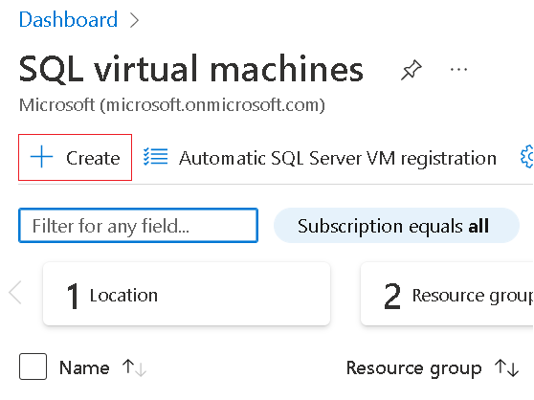
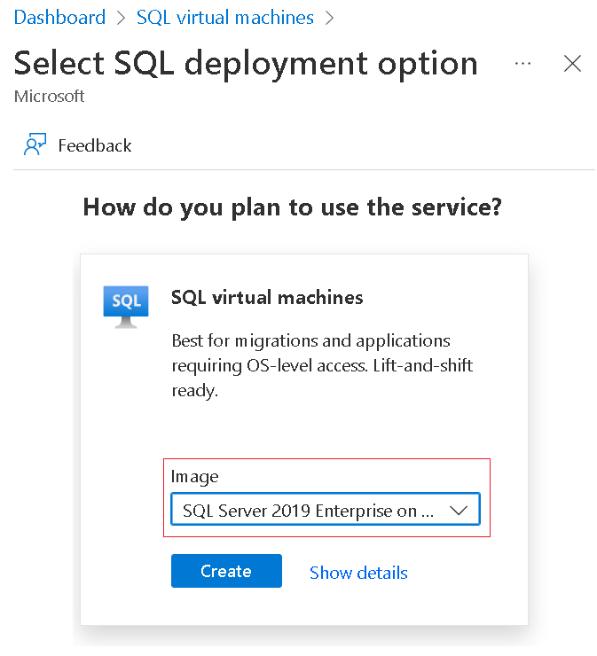
Select an Image in Azure
When creating your SQL Server Virtual Machine, select an image that is created and verified by Microsoft . The IaaS features will automatically be enabled.

Slide 19
Amber, Matt and Kirby Notes
Eduardo's input
Super lean
A workshop anybody can execute this in a day with their customers
Leverage as much corp content as possible
Shows the technical
Security
Compliance
Monitoring
Performance
Azure Advisor
Benefits of turning on the IaaS extensions on any SQL running on a VM or on VMware (AVS) on Azure.
Guidance to the people delivering this workshop of how to end it by helping the customers activate their SQL IaaS extensions
Build this fast, test it with a few customers to make sure it useful, practical, quick and works
Make or record a demo that shows the benefits, make it super tangible
CEIP Implications
Configure usage and diagnostic data collection for SQL Server (CEIP) - SQL Server | Microsoft Learn
By default, Azure VMs with SQL Server 2016 or later installed will be automatically registered with the SQL IaaS Agent extension when detected by the CEIP service.
Q: Lightweight or full mode?
Links
CSUDataAICommunityIPLibrary - Enable-IaaS-Agent-Extension - All Documents (sharepoint.com)
Azure SQL VM: What is SQL Server IaaS Agent Extension (Ep. 2) | Data Exposed
GitHub
microsoft/SQLExtentions: Repository to accelerate SQL IaaS Extension, workshop and step by step guidance (github.com)

Slide 20
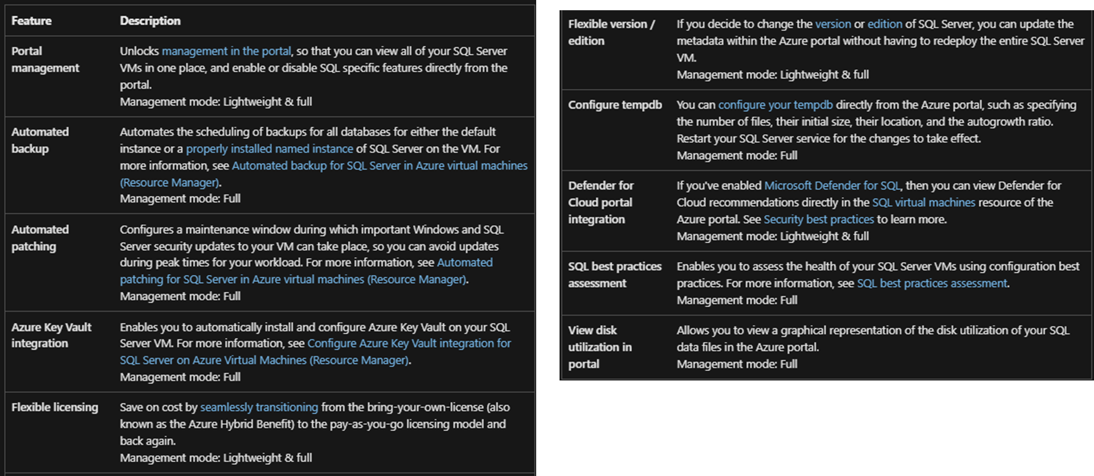
More complete list of features Matt found

Slide 21
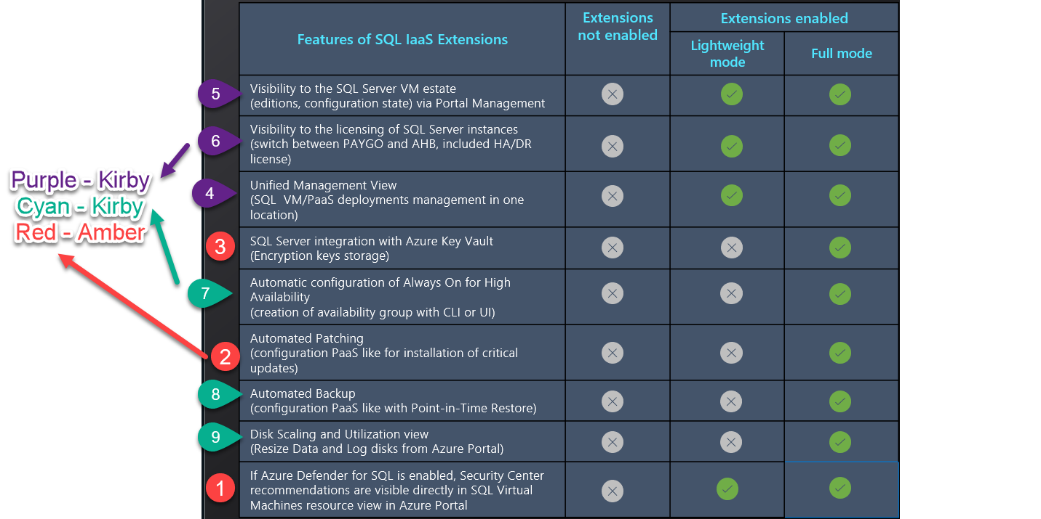

Slide 22
SQL IaaS Extensions features and capabilities

Slide 23
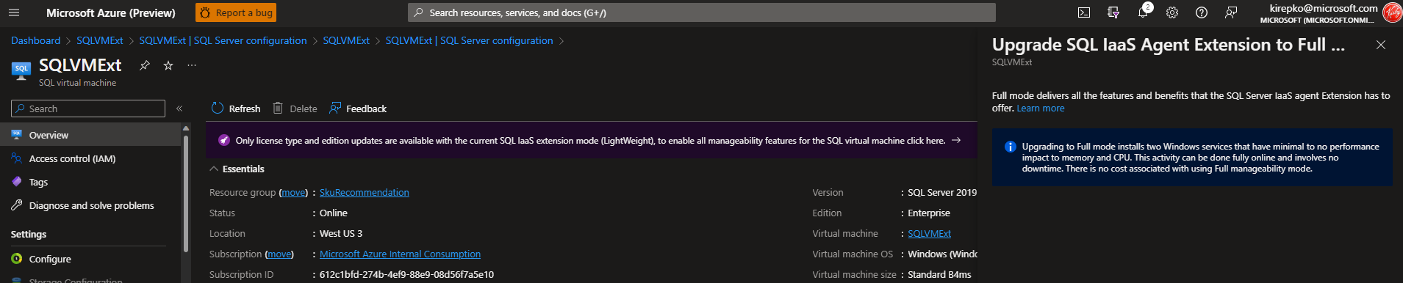
Upgrade to full from LightWeight mode

Slide 24
What is SQL Server IaaS Agent Extension?
 | Azure SQL Server VM IaaS Agent Extension enables automation of common operational tasks and makes configuration of such available via Azure Portal or CLI interfaces. In addition, this solution introduces a set of unique features and enables configuration view of SQL instance as PaaS service. Azure VMs are now discoverable on the new Azure SQL blade in Azure Marketplace. This approach unifies user experience in managing all of Azure SQL family (Azure SQL, Azure SQL MI, Azure SQL VM). Streamlining operational processes helps customers to save money and improves management of security, high availability, and storage administration. In effect, it enables customers to adopt PaaS-like capabilities with IaaS-based SQL Server at no additional charge.
 | The SQL Server IaaS Agent Extension (SqlIaasExtension service) runs on Azure virtual machines to automate administration tasks. Deploying a SQL Server VM Azure Marketplace image through the Azure portal automatically registers the SQL Server VM with the resource provider and installs the SQL Server IaaS Agent Extension (SQLIaaSAgent) on the VM. If you choose to self-install SQL Server on an Azure virtual machine or provision an Azure virtual machine from a custom VHD, you should register your SQL Server VM with the resource provider to install the SQL Server IaaS Agent Extension (SQLIaaSExtension) on the VM.
 | Self-installed VMs with IaaS extension can be easily converted to PAYG images. Save money by converting variable workloads with Software Assurance to PAYG images.
 | Self-installed VMs with IaaS extension automatically indicate usage of Azure Hybrid Benefit. Ensure compliance with Azure terms and conditions without any extra effort.
Comprehensive feature set
Dashboard view for VM awareness
Simple license conversions
Straightforward compliance

Slide 25
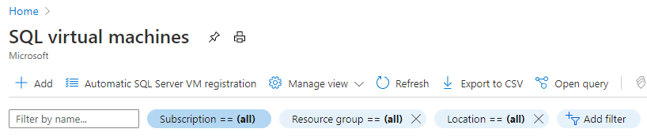
Bringing PaaS like features to Azure SQL VM
Features of SQL IaaS Extensions | Extensions not enabled | Extensions enabled
 |  | Lightweight mode | Full mode
Visibility to the SQL Server VM estate (editions, configuration state) via Portal Management
Visibility to the licensing of SQL Server instances (switch between PAYGO and AHB, included HA/DR license)
Unified Management View (SQL VM/PaaS deployments management in one location)
SQL Server integration with Azure Key Vault (Encryption keys storage)
Automatic configuration of Always On for High Availability (creation of availability group with CLI or UI)
Automated Patching (configuration PaaS like for installation of critical updates)
Automated Backup (configuration PaaS like with Point-in-Time Restore)
Disk Scaling and Utilization view (Resize Data and Log disks from Azure Portal)
If Azure Defender for SQL is enabled, Security Center recommendations are visible directly in SQL Virtual Machines resource view in Azure Portal
Automatic SQL Server VM registration button enables SQL IaaS Extensions features for all SQL VMs within a given subscription automatically.
In order to activate this feature for multiple subscriptions, the bulk action script is available.
Activation will require consent of the person who performs activation.
The request for customer consent enables to-customer statement in the opt-in that data can’t be used for audit unless the customer agrees: “Microsoft will not use this data for licensing audits without customer’s advance consent.”.
The SQL IaaS extensions will become active for all SQL Server VMs, and the features of lightweight mode will be activated within 24 hours after the activation.
Registering extension in full mode does not require restart of the server.

Slide 26
Azure SQL IaaS Extensions - management modes
Registering with the SQL Server IaaS Agent Extension automatically installs the SQL Server IaaS agent extension in one of three management modes, specified during the registration process. Not specifying the management mode will install the SQL IaaS agent extension in full management mode.
Lightweight
Does not require the restart of SQL Server
Supports only changing the license type and edition of SQL Server
Use this option for SQL Server VMs with multiple instances, or participating in a failover cluster instance (FCI)
No impact to memory or CPU
No associated cost
It is recommended to register your SQL Server VM in lightweight mode first, and then upgrade to Full mode during a scheduled maintenance window.
Full
Does not require the restart of SQL Server
Supports all functionality
Use it for managing a SQL Server VM with a single instance
Installs two windows services that have a minimal impact to memory and CPU
No associated cost
NoAgent
Dedicated only for SQL Server 2008 and SQL Server 2008 R2 installed on Windows Server 2008
No associated cost

Slide 27
SQL Server IaaS Extensions - Lightweight mode as first step
First step is to enable Lightweight mode only
Lightweight Mode (default): Enable consent for the DEV, QA and other environments to have better visibility. Validate: Observe the environments for the period of 2 weeks, at the same time review and validate scripts that can automate auto registration for bulk numbers. Identify candidate subscription for production enablement (still in the lightweight mode only). Enable lightweight in staging and production: Using script, enable auto registration on the list of given subscriptions. The enablement will take up to 24 hours to register all SQL instances. Address any issues. Reporting: Incorporate information about SQL Server licenses, editions for better visibility. Upon successful completion of the first step, your organization will immediately realize value of the SQL IaaS extensions by understating the real estate of SQL VMs, leveraging AHB benefits, ability to access SQL configuration management in a consistent PaaS like way. As your organization will complete enablement of the lightweight mode across all subscriptions, the planning and implementation of the second phase “Full Mode” could be taking place. Moving from lightweight mode to full mode will require manual or scripted enablement of the Full Mode for each of the registered SQL server VM instance. Registering extension in full mode does not require SQL server restart.
Azure SQL IaaS Extensions - single and bulk registration
There are multiple additional options how SQL Azure VM Extensions could be registered. Automatic registration for multiple subscriptions could be done by leveraging PowerShell script (provided) Single VM registration is also available via Azure Portal or Azure CLI/PowerShell If it is required to reinstall or unregister extension, it could be done via Azure Portal or Azure CLI/Azure PowerShell scripts for a single VM or bulk

Slide 28
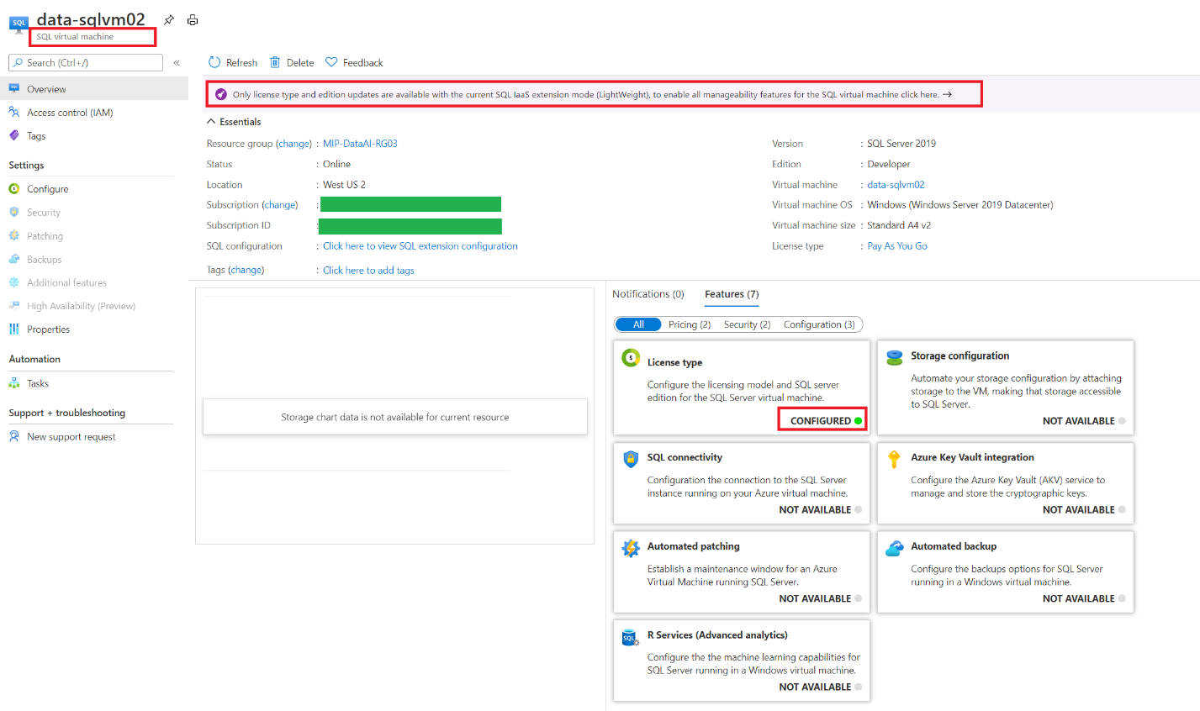
Manageability options - Lightweight Mode
Different manageability options that are enabled when the SQL Server IaaS extension is enabled
Notes:
https://techcommunity.microsoft.com/t5/sql-server/rehost-your-sql-server-to-azure-virtual-machines-for/ba-p/1698452

Slide 29
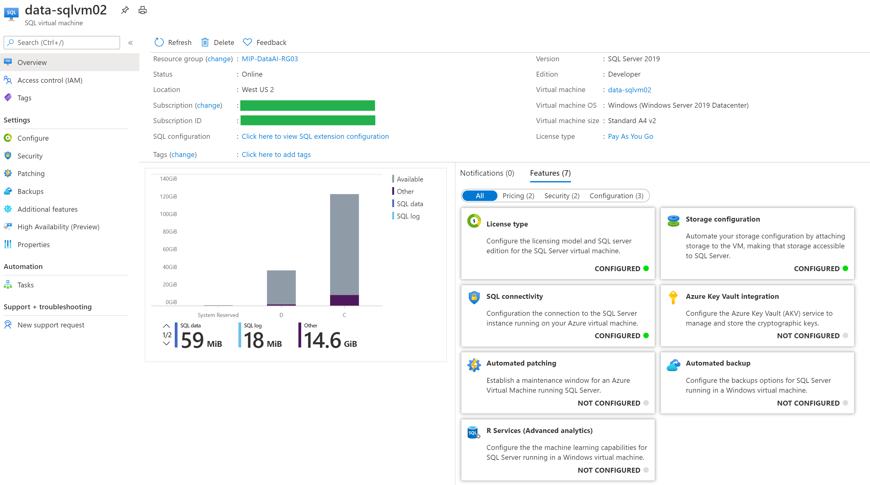
Manageability options - Full Mode
Different manageability options that are enabled when the SQL Server IaaS extension is enabled
Notes:
https://techcommunity.microsoft.com/t5/sql-server/rehost-your-sql-server-to-azure-virtual-machines-for/ba-p/1698452

Slide 30
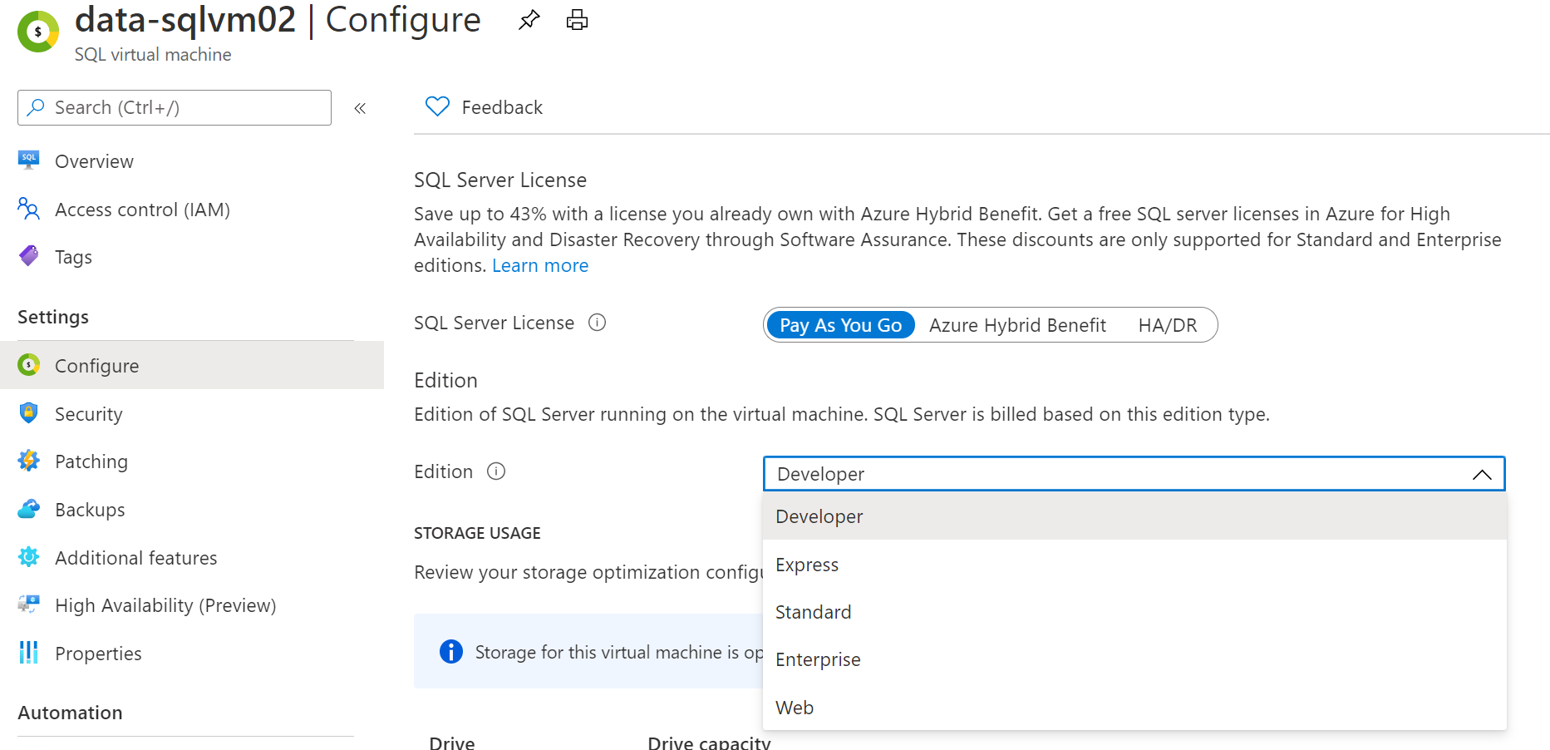
Azure SQL IaaS Extensions - License Management

Slide 31
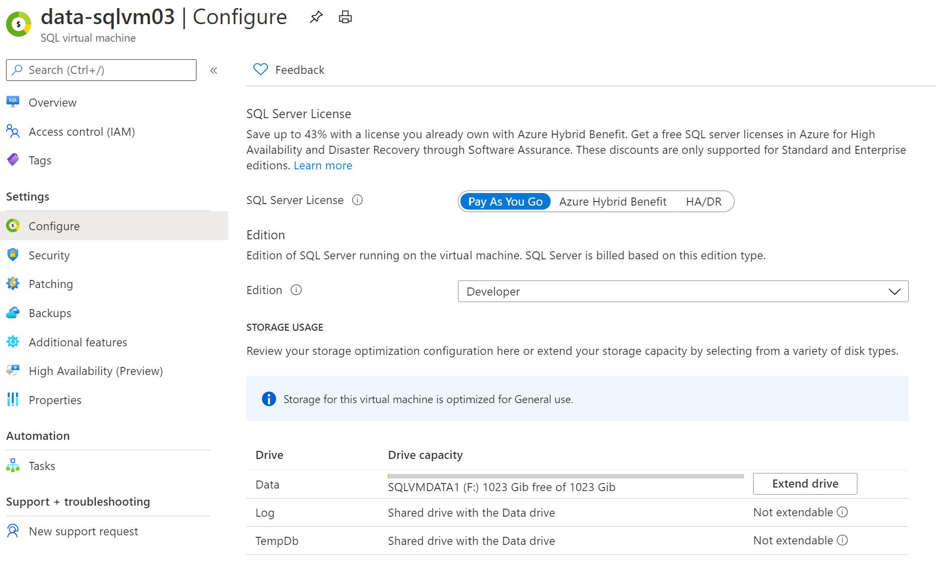
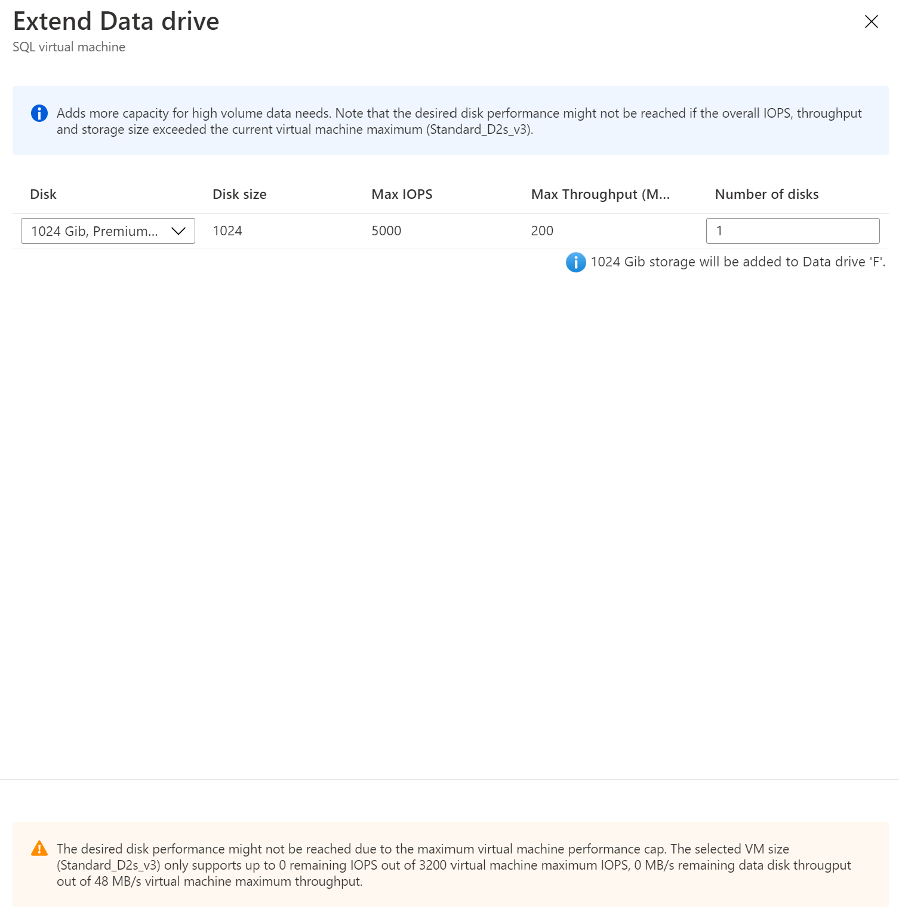
Azure SQL IaaS Extensions - Storage Configuration
Once the SQL Server virtual machine is running, you have the option of increasing the storage capacity of your disks and the wizard will help you determine if you are picking a configuration setting which could be the victim of a capacity limit.
Extending drives adds more storage capacity but does not add more IOPS and throughput capacity. If you need more IOPS and throughput, you will need to build a new storage pool and migrate the data to the new pool.

Slide 32
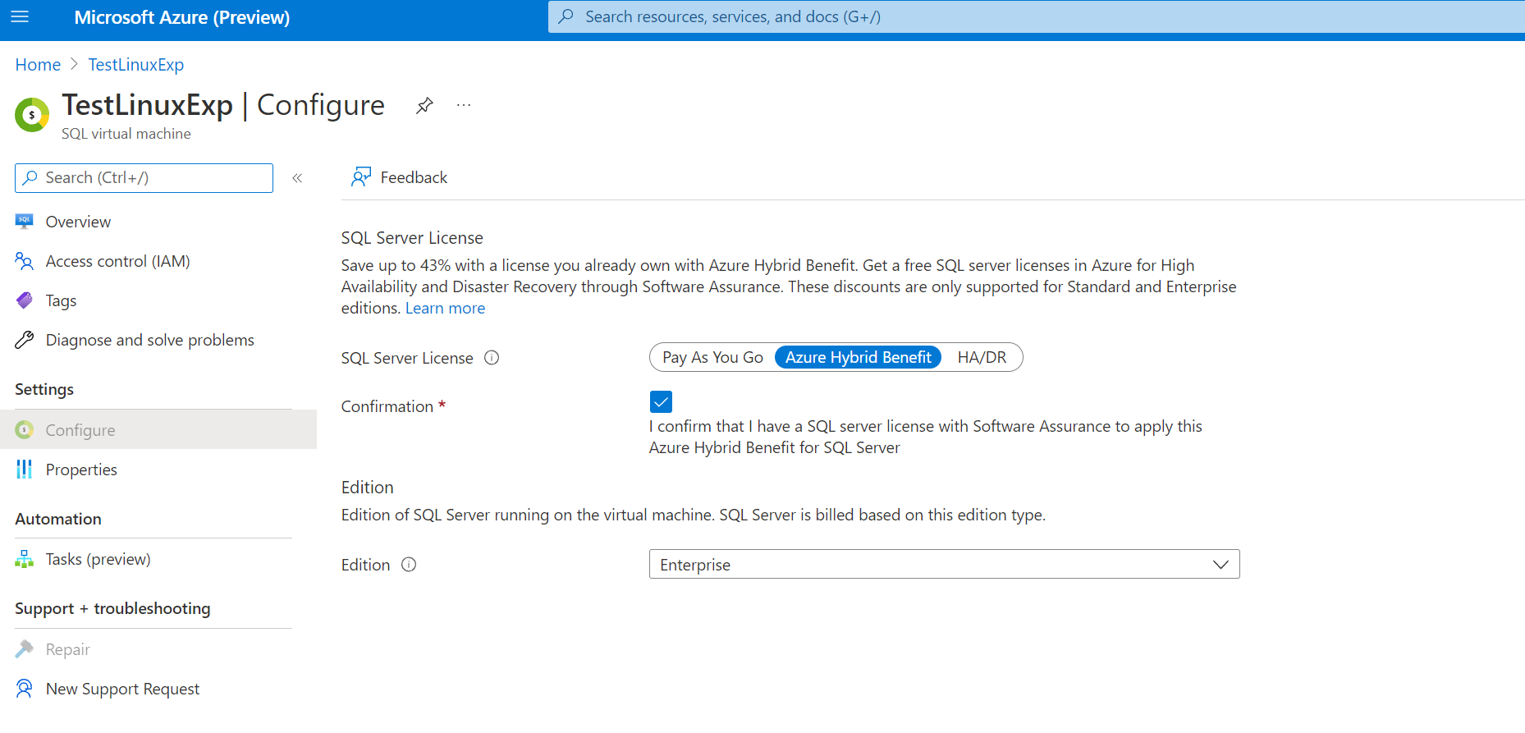
AHB benefits (including reclass) now available for SQL on Linux

Slide 33
Azure SQL IaaS Extensions - Azure Key Vault Integration
Different SQL Server encryption features, such as transparent data encryption (TDE), column level encryption (CLE), and backup encryption, require you to manage and store the cryptographic keys you use for encryption.
The Azure Key Vault service is designed to improve the security and management of these keys in a secure and highly available location.
When this feature is enabled, it automatically installs the SQL Server Connector, configures the EKM provider to access Azure Key Vault, and creates the credential to allow you to access your vault.
Create a new key vault using New-AzKeyVault command. It will return vaultUri property, which is the key vault URL.
After key vault is created, add your keys to the key vault.
Steps:

Slide 34
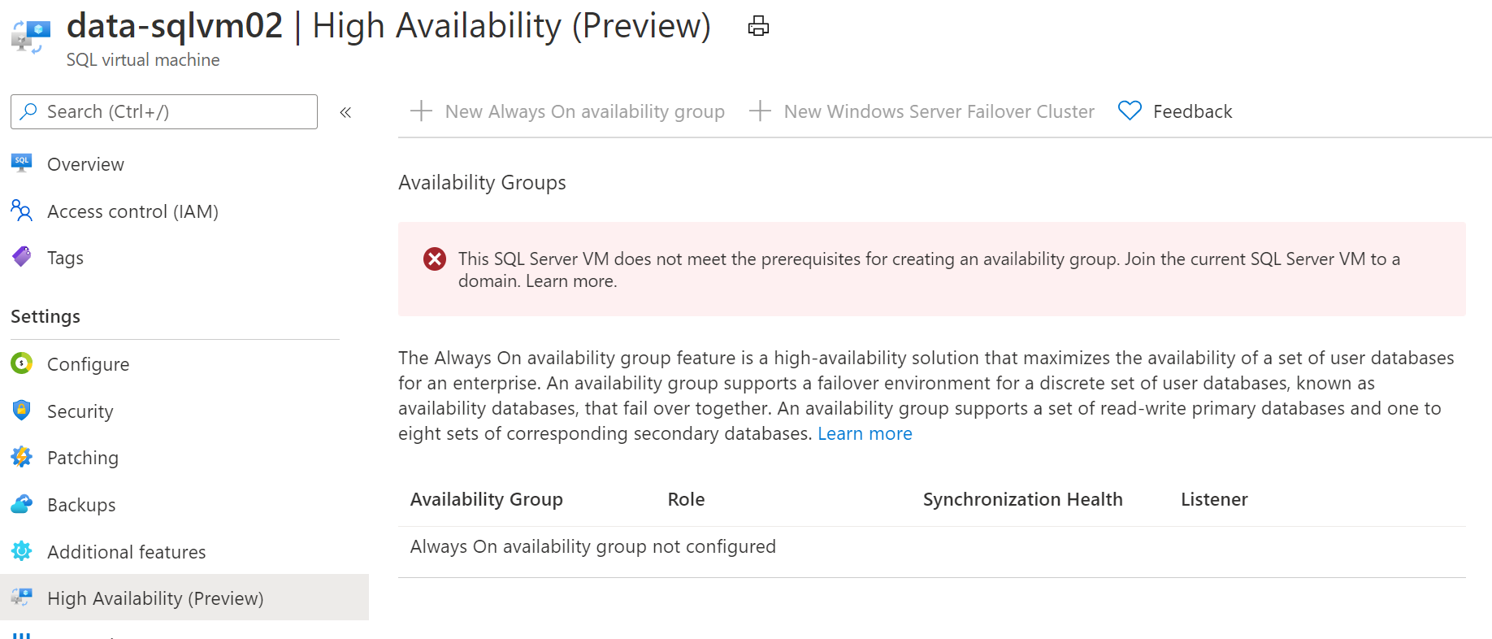
Azure SQL IaaS Extensions - High Availability
The new High Availability feature allows you to create a new cluster or onboard an existing cluster, and then create the availability group, listener, and internal load balancer.
SQL Server on Azure Virtual Machines helps to reduce licensing cost when deploying highly available environment if a customer has Software Assurance or is using SQL Server subscription licenses.
Example: Assuming that current workload is running SQL Server virtual machine topology having one primary replica, one synchronous passive secondary replica and one asynchronous passive replica. The customer would need to license only primary replica (given that number of cores on all three replicas is the same). The customer could use Always On Availability Group as the High Availability and Disaster Recovery feature, as well, can leverage this benefit with other SQL Server features like Failover Cluster Instances, Log Shipping, Database Mirroring and Backup and Restore.

Slide 35
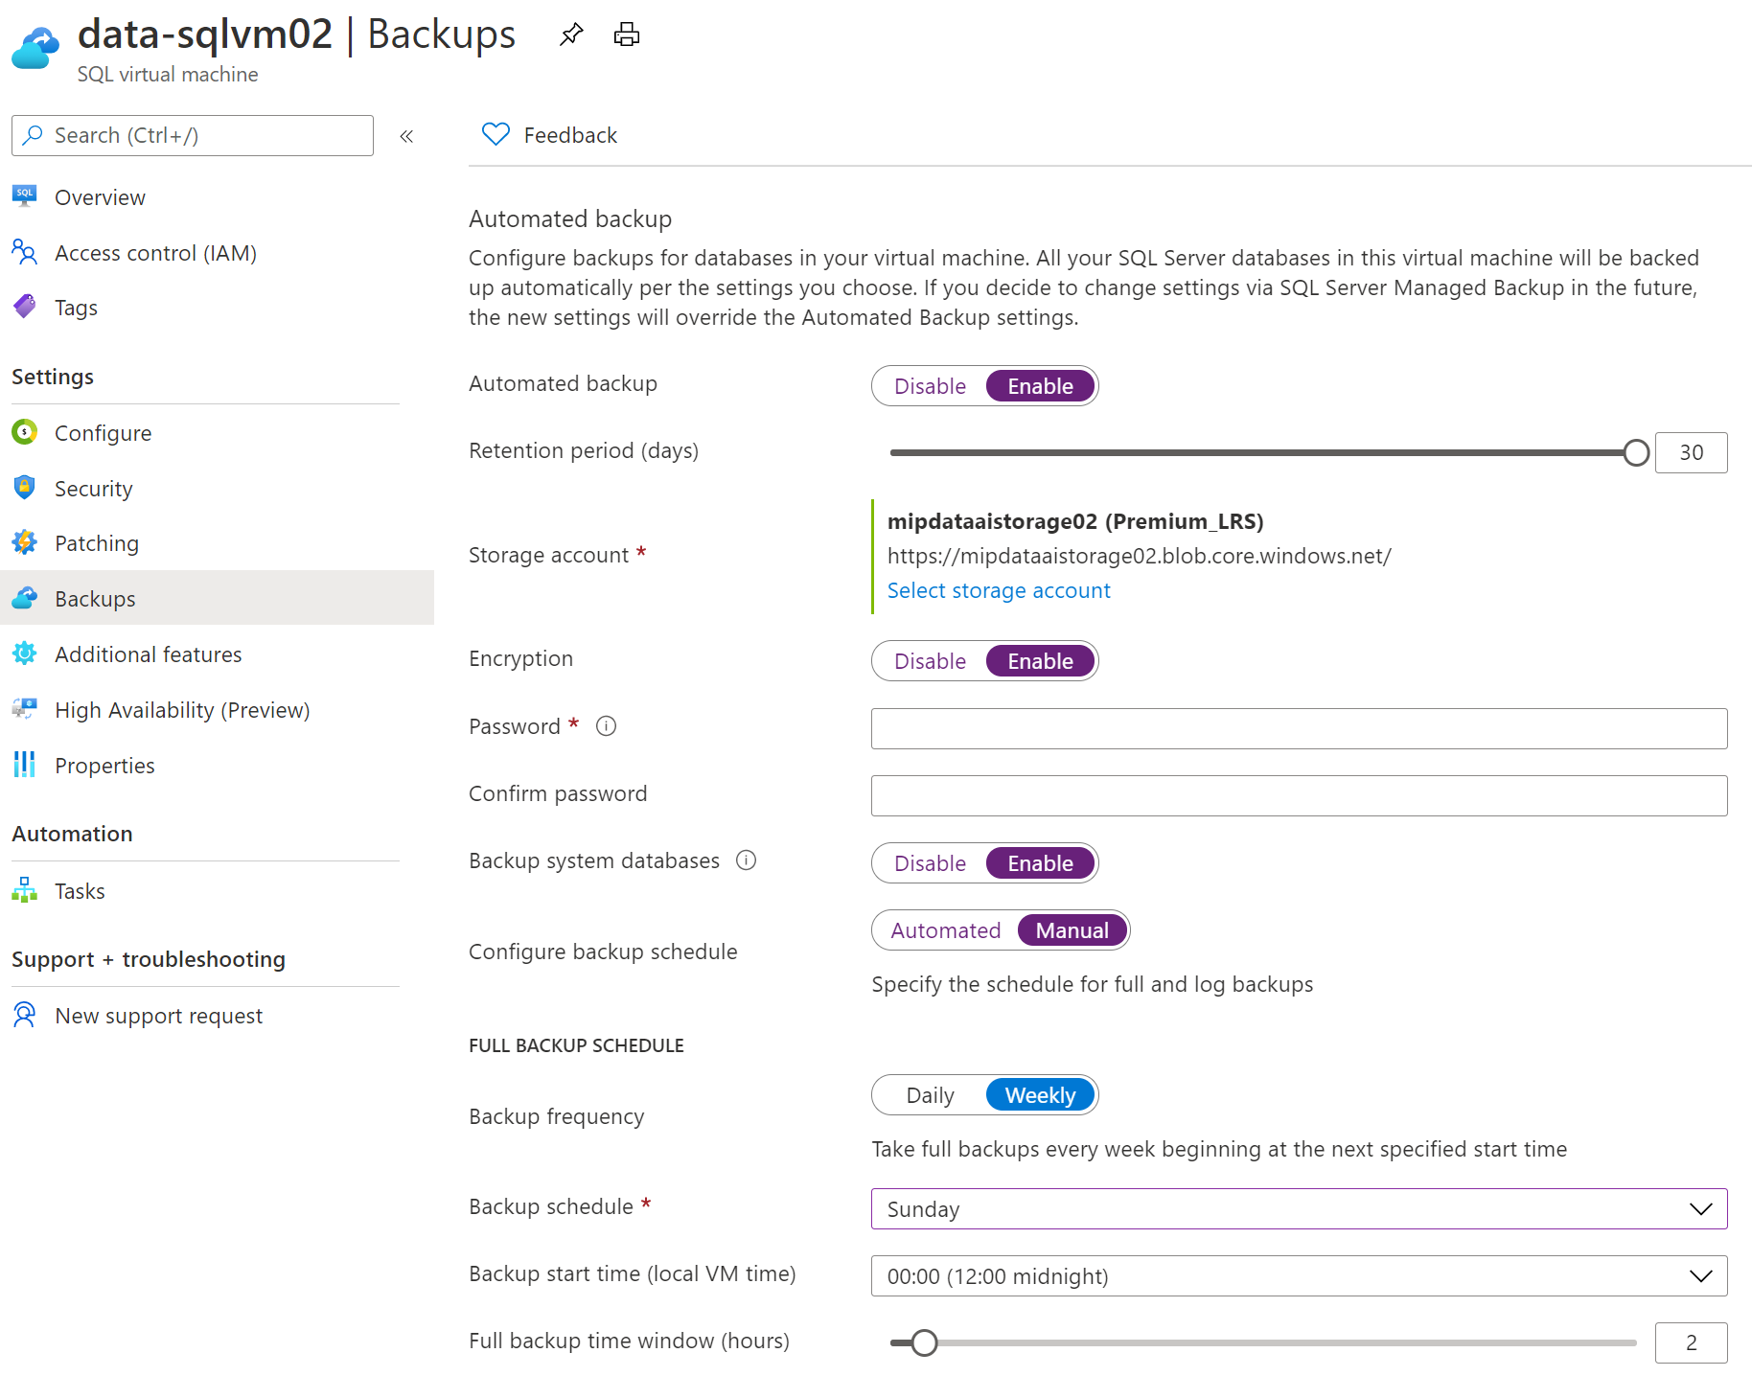
Azure SQL IaaS Extensions - Automated Backup
The Automated Backup feature allows you to setup SQL Server backups with various options like encrypting backups, set a retention period, backup system databases, configuring a manual backup schedule or setting up an automated backup.
Available for SQL Server 2014+
Service provided by the SQL IaaS Agent Extension
Leverages Managed Backup to URL
SQL Server 2016+: Automated Backup v2 for Azure Virtual Machines
SQL Server 2014: Automated Backup for SQL Server 2014 Virtual Machines
Must be running the extension in Full mode
Back up to an Azure storage account that you configure
Supports encryption
Retain backups up to 30 days
https://docs.microsoft.com/en-us/azure/azure-sql/virtual-machines/windows/automated-backup
https://docs.microsoft.com/en-us/azure/azure-sql/virtual-machines/windows/automated-backup-sql-2014
Notes:
https://docs.microsoft.com/en-us/azure/azure-sql/virtual-machines/windows/automated-backup
https://docs.microsoft.com/en-us/azure/azure-sql/virtual-machines/windows/automated-backup-sql-2014

Slide 36
Azure SQL IaaS Extensions - Automated Patching Feature
The Automated Patching feature allows a SQL Server administrator to select a maintenance window schedule for applying Important Windows Server and SQL Server updates that are distributed through the Windows Update channel.

Slide 37
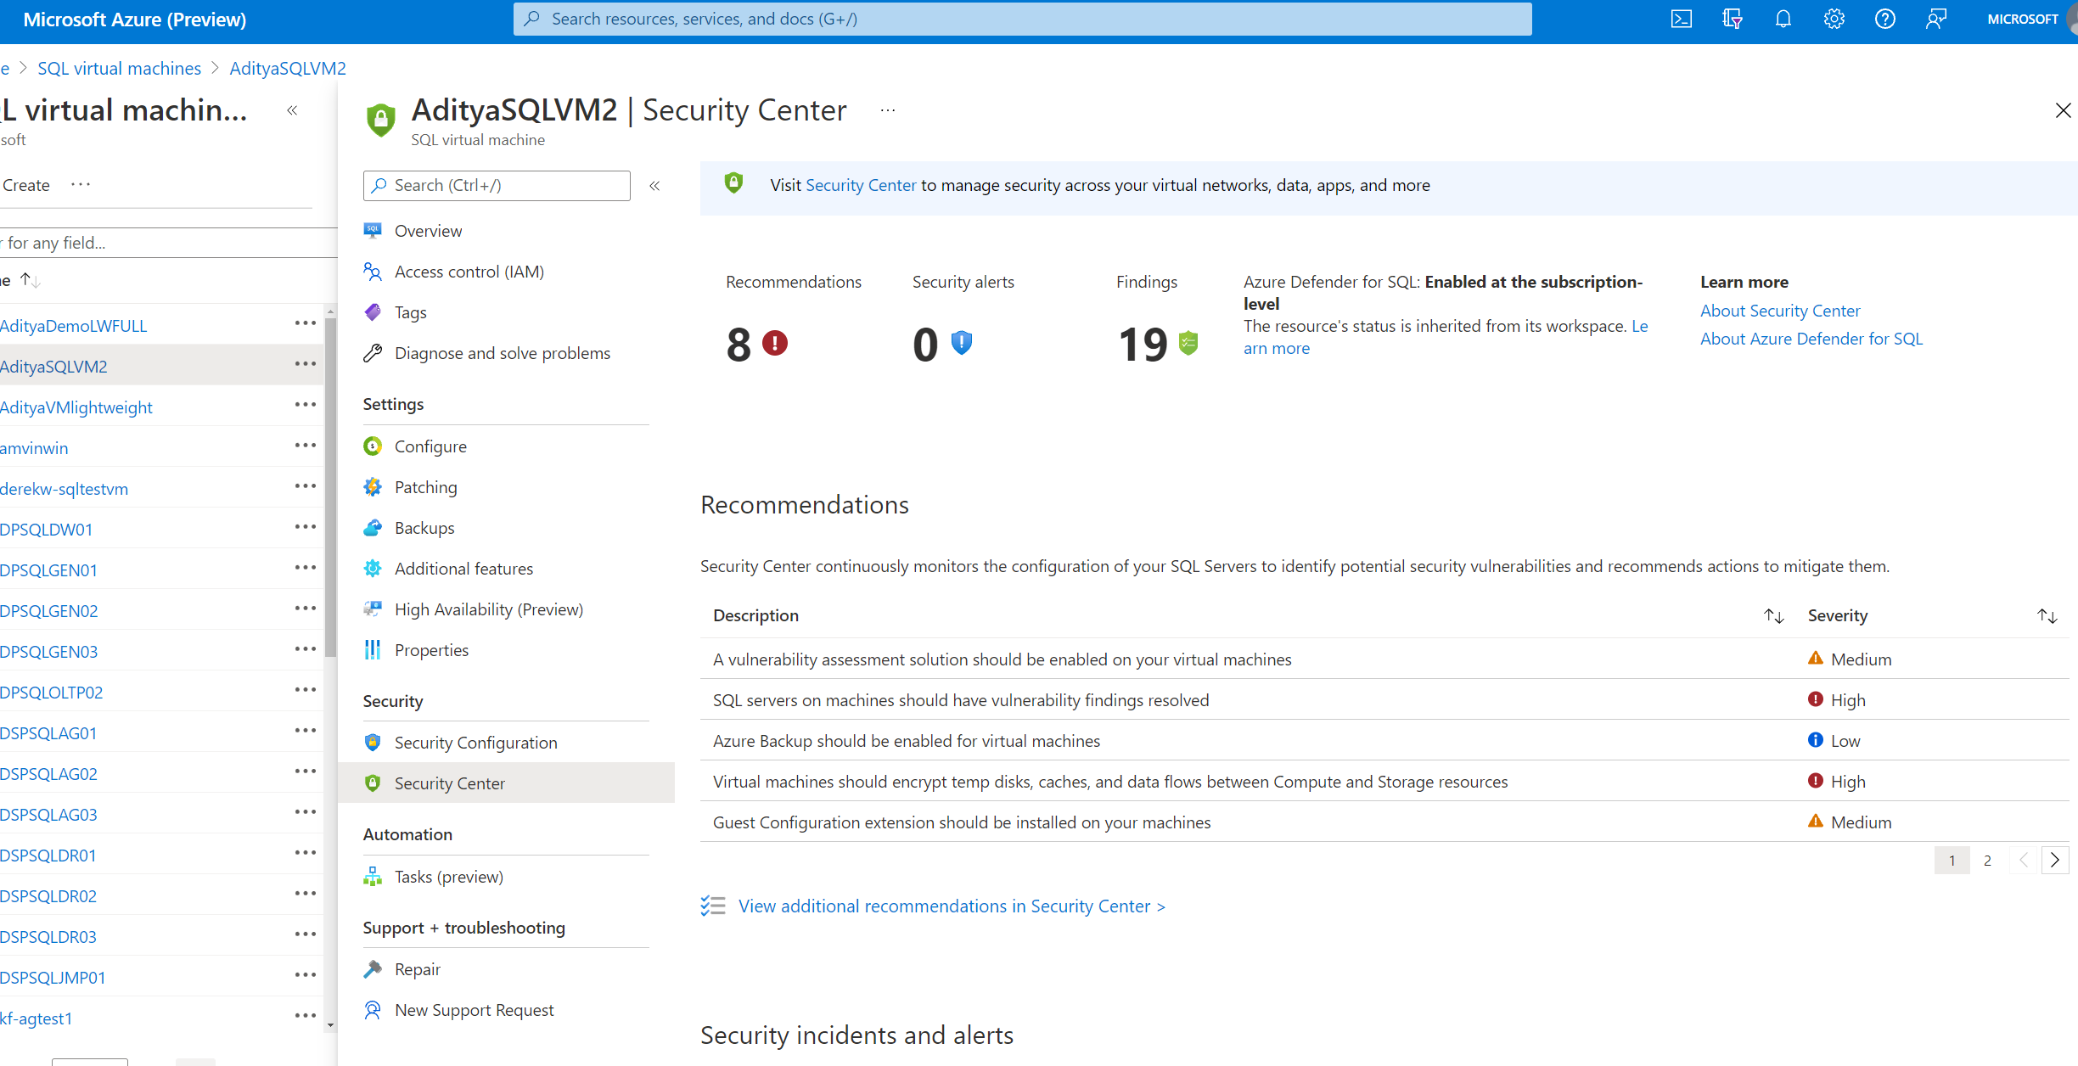
Get security recommendations right in your SQLVM blade

Slide 38

Easily view and manage your SQL licenses
Inventory Management
Gain a clear picture of your Azure SQL IaaS and PaaS by viewing and managing different license types
Flexible licensing
Switch between pay as you go (PAYG) and Azure Hybrid Benefit (AHB) license models to optimize your SQL Server license cost when you are not running your Azure SQL VMs 24x7.
In-place edition updates
Upgrade supported SQL Server edition paths with no impact to availability
HA/DR license type
Software Assurance customers can take advantage of free HA and DR replicas

Slide 39
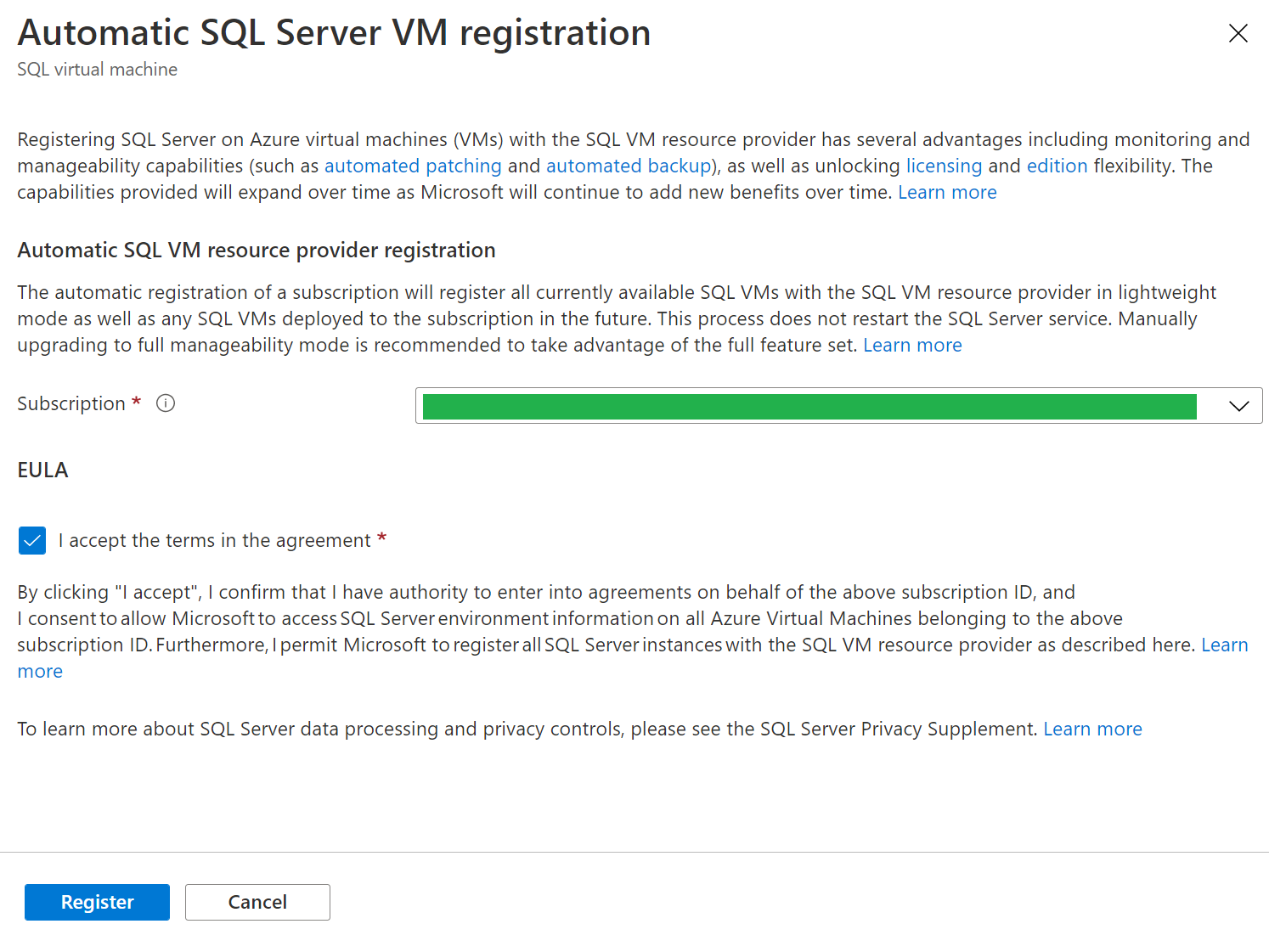
Azure SQL IaaS Extensions - Automatic Registration
The automatic registration feature allows customers to automatically register all current and future SQL Server VMs in their Azure subscription with the SQL VM IaaS Agent Extension
Automatic registration registers your SQL Server VMs in lightweight mode which does not touch the SQL Server service or databases at all, it’s simply a lightweight background agent.
Manual upgrade is required to full manageability mode to take advantage of the full feature set. Once it is upgraded to FULL mode, simply grant access to the agent login, no restart is required.

Slide 40
Azure SQL IaaS Extensions - single and bulk registration
There are multiple additional options how SQL Azure VM Extensions could be registered.
Automatic registration for multiple subscriptions could be done by leveraging PowerShell script (provided)
Single VM registration is also available via Azure Portal or Azure CLI/PowerShell
If it is required to reinstall or unregister extension - it could be done via Azure Portal or Azure CLI/Azure PowerShell scripts for a single VM or bulk

Slide 41
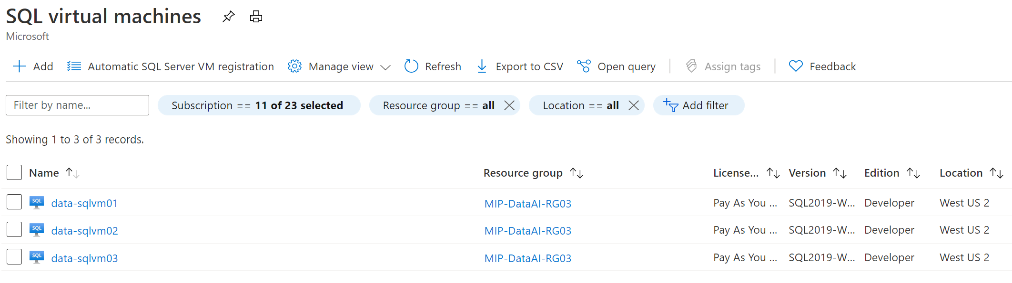
Discover Azure VMs running SQL Server
Azure Marketplace SQL Server Images
Microsoft Certified Images
Provision SQL VM in ~5 min
Choose PAYG or AHB licensing models
SQL VM IaaS extension is enabled by default
Custom installed SQL Server instances
SQL Server installation is owned by you
Requires indicating AHB usage to Microsoft
Enables only Virtual Machine services
You should register with SQL VM IaaS extension to access free SQL Server Manageability
Notes:
You can either use a SQL Server image on Azure Marketplace or use your own custom image with SQL Server to deploy SQL Server on Azure VMs.
Azure Marketplace offers SQL Server images with all editions from SQL Server 2008 to SQL Server 2019.
If you provision the VM form SQL image through portal SQL VM Iaas extension comes as enabled by default.
IF you installed SQL server from your own media or from your custom image, then you can register with SQL VM IaaS extension.

Slide 42
Microsoft support and resources
Microsoft account team will provide any additional details and assistance if required.
If you require support to enable large number of subscriptions, reach out Microsoft account team.
Microsoft documentation:
Automatic registration with SQL IaaS Agent extension
Automate management with the SQL Server IaaS Agent extension
Register multiple SQL VMs in Azure with the SQL IaaS Agent extension
FAQ for Extensions
Product Group Postings on Azure SQL Server on VM including information about extensions
Product Group github with scripts

